Slide 1
Relations-Foreign Key- Data manipulation language (DML)

Slide 2
Agenda
• Relationships
• Degree of Relationships ?
• Foreign Key Relationships in PostgreSQL
• Foreign Key Constraints (CASCADE, SET NULL, RESTRICT)
• Data manipulation language (DML) (Insert-Update)(Delete-Select into next slide)

Slide 3
Relationship
• It describes the association between two entities.
• Example: The relationship between two entities Student and Class has many to many relationship.

Slide 4
Degree of Relationships
There are 3 types of degrees of relationship:
• Unary relationship
• Binary relationship
• Ternary relationship

Slide 5
Unary Relationship
Definition: A Unary Relationship occurs when one entity is related to another instance of the same entity type.
Example: An EMPLOYEE can supervise another EMPLOYEE.
Example scenario:
One employee is a manager
Other employees report to that manager
This means the relationship happens within the same table.

Slide 6
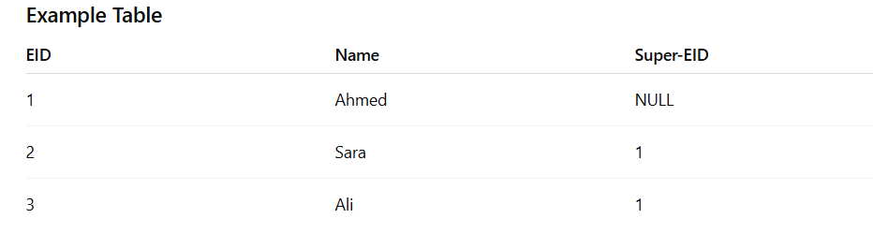
Unary Relationship

Slide 7
Binary Relationship
Entities of two different types related to each other.
Teacher — Teaches — Subject
Example
A Teacher teaches a Subject.
Entities involved:
Teacher
Subject
Relationship:
Teaches

Slide 8
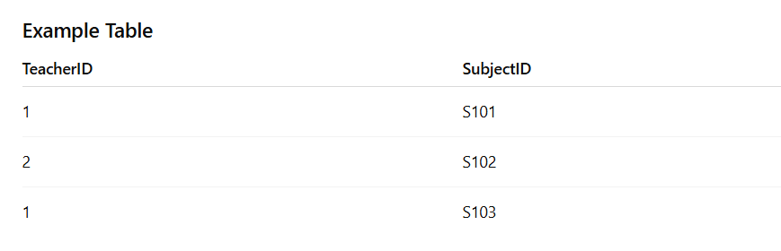
Binary Relationship
Explanation:
Teacher 1 teaches Subject S101
Teacher 2 teaches Subject S102
Teacher 1 also teaches Subject S103

Slide 9
Ternary Relationship
Definition: A Ternary Relationship occurs when three different entities participate in the same relationship.
This means the relationship connects three tables at the same time.
Example
A Teacher teaches a Subject to a Student.
Example scenario:
A teacher teaches Math
A specific student attends that class
So the relationship involves:
Teacher
Subject
Student
All three entities are required to describe the relationship.

Slide 10
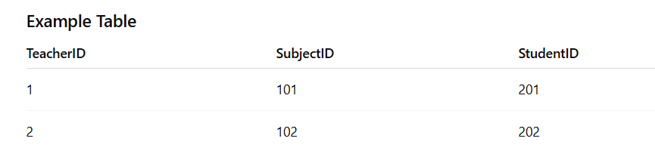
Ternary Relationship
Explanation:
Teacher 1 teaches Subject 101 to Student 201
Teacher 2 teaches Subject 102 to Student 202

Slide 11
Cardinality of Relationships
• Cardinality of a relationship can be defined as the number of times an entity of an entity set participates in a relationship set.
• Cardinality shows how the entities are connected to each other.
Types of cardinalities between tables are:
- One-to-One
- One-to-Many
- Many-to-Many

Slide 12
One-to-One Relationship
A One-to-One (1:1) relationship is a type of binary relationship where each entity in one set is associated with exactly one entity in the other set, and vice versa.
Example: Person — 1 — Has — 1 — Passport
Each person has exactly one passport.
Each passport belongs to exactly one person.

Slide 13
One-to-Many Relationship
An entity in set A can be linked with any number of entities in set B while an entity in set B can be linked with only one entity in set A.
Example: Customer — 1 — Places — N — Order
A single customer can place many orders.
Each order is placed by only one customer.

Slide 14
Many-to-Many Relationship
An entity in set A can link to any number of entities in set B while an entity in set B can link to any number of entities in set A.
Example: Customer — M — Buys — N — Product
A single customer can buy many products.
A single product can be bought by many customers

Slide 15
What is Relational Mapping / ORM?
Definition:
ORM (Object-Relational Mapping) is a technique that maps database tables and relationships to objects in code, so developers can interact with data as objects instead of writing SQL queries.
Tables → Classes / Objects
Rows → Object Instances
Columns → Object Attributes
Relationships → Object References / Lists / Collections

Slide 16
How It Works in PostgreSQL
How It Works in PostgreSQL
PostgreSQL stores data in tables with rows and columns
Each table becomes an Object Class in the code
Foreign keys represent relationships as object references

Slide 17
Example:
Table | ORM Object | Relationship
EMPLOYEE | Employee Class | N:1 → Department
DEPARTMENT | Department Class | 1:N → Employees
PROJECT | Project Class | M:N → Employees (WORKS_ON junction table)

Slide 18
CRUD via ORM:
Create → $employee = new Employee(); $employee->save();
Read → $employee = Employee::find(1);
Update → $employee->salary = 6000; $employee->save();
Delete → $employee->delete();

Slide 19
How It Works in ServiceNow
ServiceNow stores data on similar relational DB
Tables are exposed as Objects / Records in ServiceNow
Developers use GlideRecord API or Scripts to access these objects instead of SQL

Slide 20
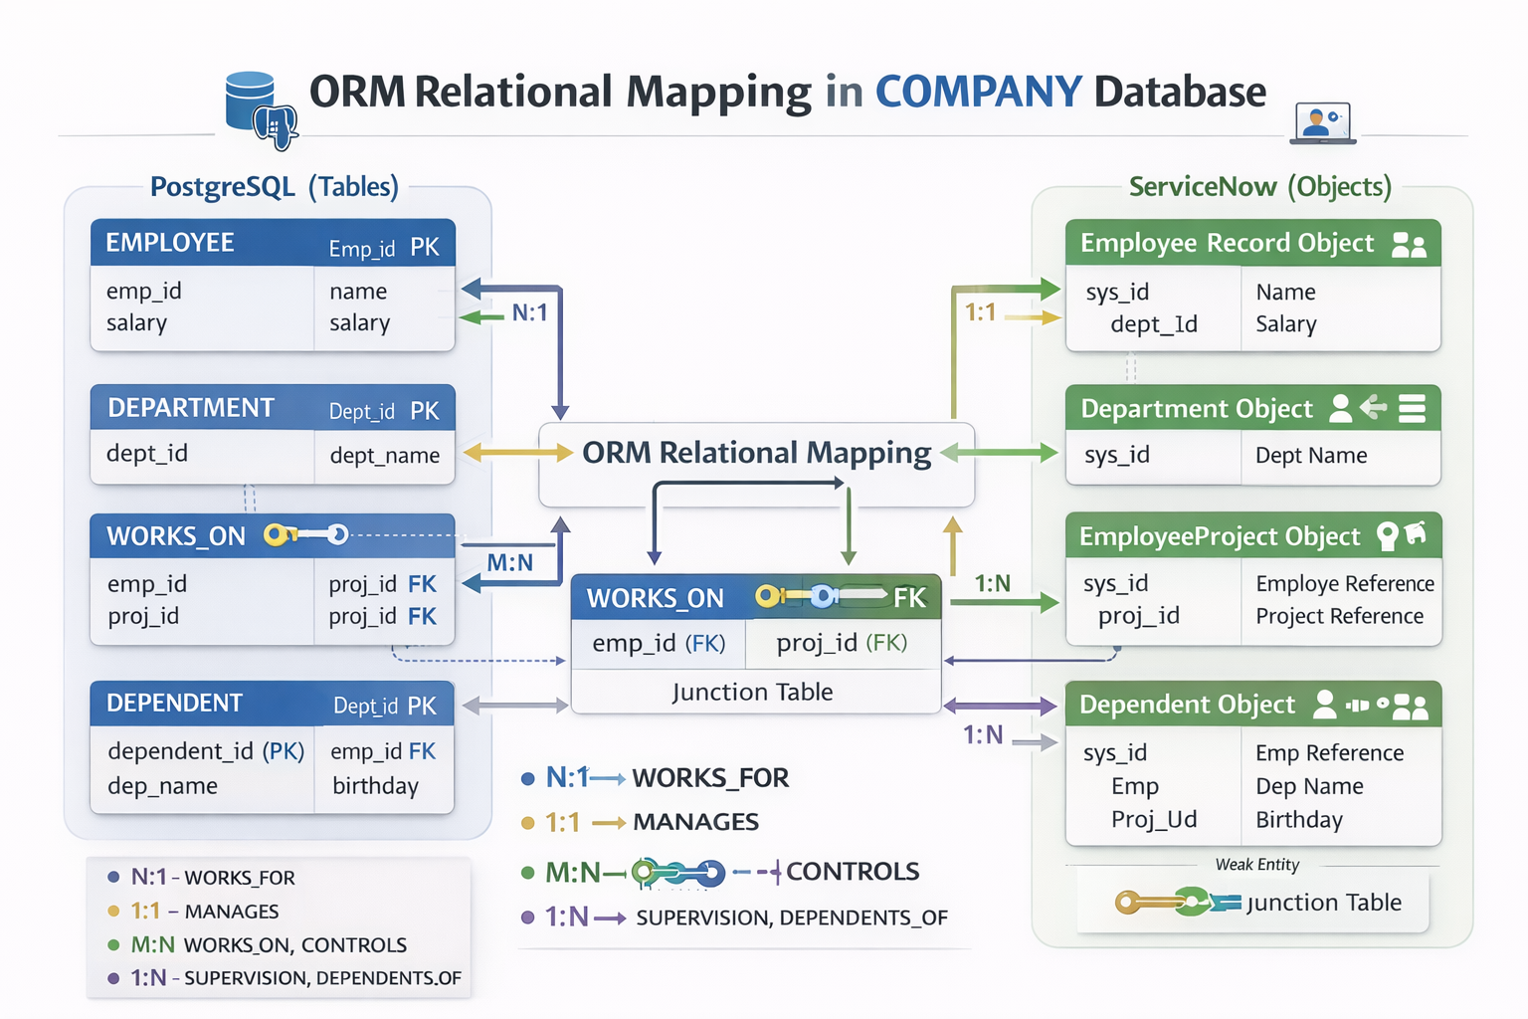

Slide 21
Foreign Key & Actions in PostgreSQL

Slide 22
Foreign Key
A Foreign Key (FK) is a column in a table that references the Primary Key (PK) of another table to enforce referential integrity.
When defining an FK, you can specify actions for what happens when the referenced row is updated or deleted.

Slide 23
Foreign Key
One-to-One Relation
Example: User → Profile
CREATE TABLE users ( id SERIAL PRIMARY KEY, username VARCHAR(100) ); CREATE TABLE profiles ( id SERIAL PRIMARY KEY, bio TEXT, user_id INT UNIQUE, FOREIGN KEY (user_id) REFERENCES users(id) );
UNIQUE makes the relationship One-to-One.

Slide 24
Foreign Key
One-to-Many Relation (Most Common)
Example: One Department → Many Employees
Create Parent Table
CREATE TABLE departments ( id SERIAL PRIMARY KEY, name VARCHAR(100) );
Create Child Table with Foreign Key
CREATE TABLE employees ( id SERIAL PRIMARY KEY, name VARCHAR(100), department_id INT, FOREIGN KEY (department_id) REFERENCES departments(id) );

Slide 25
Foreign Key
Many-to-Many Relation
Example: Students ↔ Courses
A student can take many courses, and a course has many students.
Step 1: Tables
CREATE TABLE students ( id SERIAL PRIMARY KEY, name VARCHAR(100) ); CREATE TABLE courses ( id SERIAL PRIMARY KEY, title VARCHAR(100) );
Step 2: Junction Table
CREATE TABLE student_courses ( student_id INT, course_id INT, PRIMARY KEY (student_id, course_id), FOREIGN KEY (student_id) REFERENCES students(id), FOREIGN KEY (course_id) REFERENCES courses(id) );

Slide 26
Actions in PostgreSQL

Slide 27
CASCADE
Definition:
When a referenced row is deleted or updated, the change is automatically applied to the dependent rows.
Example:
CREATE TABLE Department (
dept_id SERIAL PRIMARY KEY,
name VARCHAR(50)
);
CREATE TABLE Employee (
emp_id SERIAL PRIMARY KEY,
name VARCHAR(50),
dept_id INT REFERENCES Department(dept_id) ON DELETE CASCADE
);

Slide 28
RESTRICT
Definition:
Prevents deletion or update of a referenced row if dependent rows exist.
Example:
CREATE TABLE Employee (
emp_id SERIAL PRIMARY KEY,
name VARCHAR(50),
dept_id INT REFERENCES Department(dept_id) ON DELETE RESTRICT
);

Slide 29
SET NULL
Definition:
When the referenced row is deleted/updated, the FK in dependent rows is set to NULL.
Example:
CREATE TABLE Employee (
emp_id SERIAL PRIMARY KEY,
name VARCHAR(50),
dept_id INT REFERENCES Department(dept_id) ON DELETE SET NULL
);

Slide 30
NOT NULL (Constraint)
Definition:
Ensures FK column cannot be NULL. Often combined with FK constraints.
Example:
CREATE TABLE Employee (
emp_id SERIAL PRIMARY KEY,
name VARCHAR(50),
dept_id INT NOT NULL REFERENCES Department(dept_id)
);

Slide 31
Data manipulation language (DML)

Slide 32
Data manipulation language (DML)
● Data manipulation language (DML) provides operations that handle user
requests, offering a way to access and manipulate the data that users
store within a database.
● Its common functions include inserting, updating and retrieving data
from the database.

Slide 33
DML statements
● INSERT: Adds new data to the existing database table
● UPDATE: Changes or updates values in the table
● DELETE: Removes records or rows from the table
● SELECT: Retrieves data from the table or multiple tables

Slide 34
INSERT INTO Statement
● The INSERT INTO statement is used to insert new records in a table.
● Syntax
INSERT INTO table_name (column1, column2, column3, ...)
VALUES (value1, value2, value3, ...);
● Example
INSERT INTO Persons (ID,FirstName,LastName,Age,City)
VALUES (1,'Alfred','Schmidt',20,'Norway');

Slide 35
UPDATE Statement
● The UPDATE statement is used to modify the existing records in a table.
● Syntax
UPDATE table_name
SET column1 = value1, column2 = value2, ...
WHERE condition;
● Example
UPDATE Persons SET City='Frankfurt'
WHERE ID=1;

Slide 36
Thank you

